Slide 1

Airbnb Price Prediction
Building a price recommendation system for new airbnb hosts through data mining and numeric prediction modeling

Slide 2








Team Members
Dipeeka Bastola
Frank Fan
Sebastian Peña
Zihan Wang

Slide 3
Agenda
Business Problem
Airbnb platform, customer base, and value proposition
New hosts’ need for pricing tool on their listing
Existing listings serve to predict new listing price
Data Understanding & Preparation
Description of New York City airbnb listings dataset
Data and variable exploration
Feature engineering, text analysis, clustering
Modeling
Numeric prediction models built
Feature management
Hyperparameter tuning
Evaluation & Deployment
Model evaluation metric performance
Model deployment within airbnb
Risks & ethical concerns

Slide 4
Business Understanding
Airbnb’s major source of revenue comes from service fees attached to listings. Optimizing price on new listings can lead to sustainable growth through value maximization and host retention.

Slide 5

Airbnb currently works alongside more than 2M hosts
Homes & experiences
Service fees
No hospitality background
Limited pricing capability
Notes:
This earnings estimate assumes 15 nights booked per month at forecasted daily prices. The forecasted daily prices are based on average prices for listings with a similar location, listing type, and guest capacity. How much you actually make may vary with your pricing, type and location of your listing, actual occupancy rate, season, demand, local laws, and other factors.
Online marketplace for arranging homestays and experiences for over 2,500,000 hosts
Price is the driver of revenue
Majority of revenue is derived from service fee which is a function of nightly price
Hosts
Majority without professional hospitality backgrounds
No experience pricing rentals
Current Platform for new hosts
A preliminary price estimation based on just location, listing type and guest capacity
Users decide the base price

Slide 6

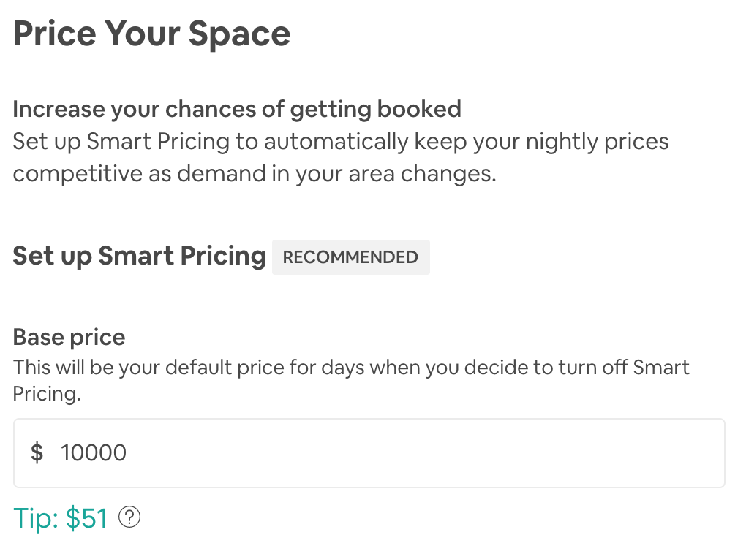
New hosts receive limited assistance
Business Problem:
New hosts need to set the base price for their new listing but they have no point of reference except the preliminary price estimation*
Solution：
Expand existing pricing capabilities with a base price prediction model specifically for potential hosts
* This earnings estimate assumes 15 nights booked per month at forecasted daily prices. The forecasted daily prices are based on average prices for listings with a similar location, listing type, and guest capacity.
Notes:
This earnings estimate assumes 15 nights booked per month at forecasted daily prices. The forecasted daily prices are based on average prices for listings with a similar location, listing type, and guest capacity. How much you actually make may vary with your pricing, type and location of your listing, actual occupancy rate, season, demand, local laws, and other factors.

Slide 7
Data Understanding & Preparation
Data was cleaned through extensive data comprehension, in-depth data exploratory analysis, and selective feature engineering in preparation for model development

Slide 8
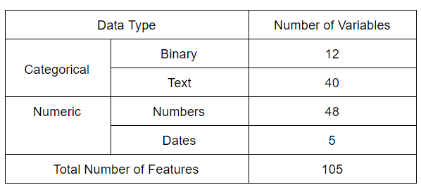
Data Understanding - Source and Features
New York City listings on Aug 4th, 2019 from InsideAirbnb.com
Nearly 50,000 observations, 105 features
Property Description - property type, number of beds, number of bathrooms, nightly price, neighborhood, amenities
Reservation Details - number of guests, number of days reserved
Customer Feedback - text description and points
Notes:
Description of Listing: Attributes such as neighborhood, city, amenities, types of rooms and property type provide more insights on the listings.
Customer Feedback: Attributes such as reviews and customer scores provide information on customer satisfaction for the listings.
Reservation Details: Attributes such as cancellation policies, pricing for various time frames and availability provide details on the reservations for the listings.

Slide 9
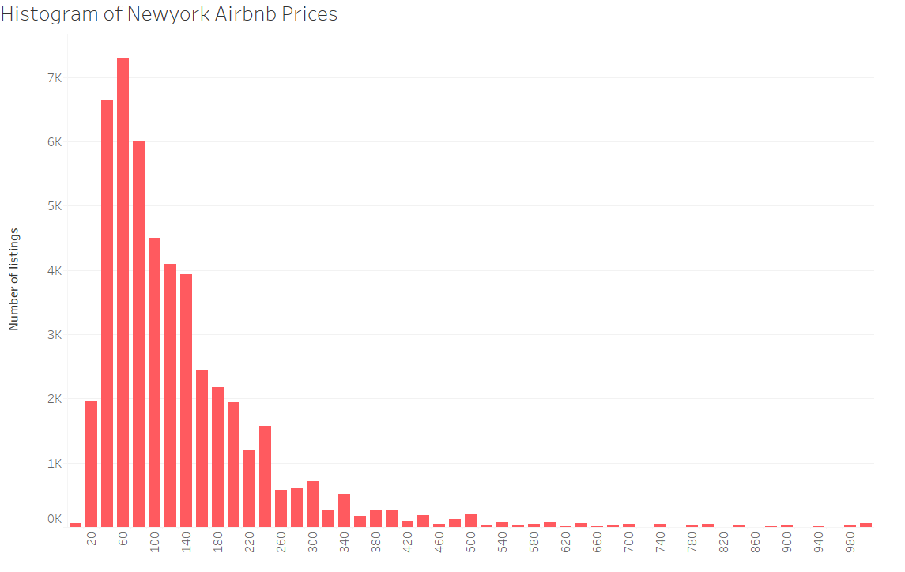
Data Understanding - Target Variable
Target: Price per night (numeric)
Characteristics:
Heavily right skewed
Majority of listings below $500
Avg = $151, Stdev = $236
Range: 0 to 9999
Preparation:
Removed prices over +3 * Stdev
Considered luxury
Set high prices to deter booking
0.008% observations removed
Listings considered “normal”

Slide 10
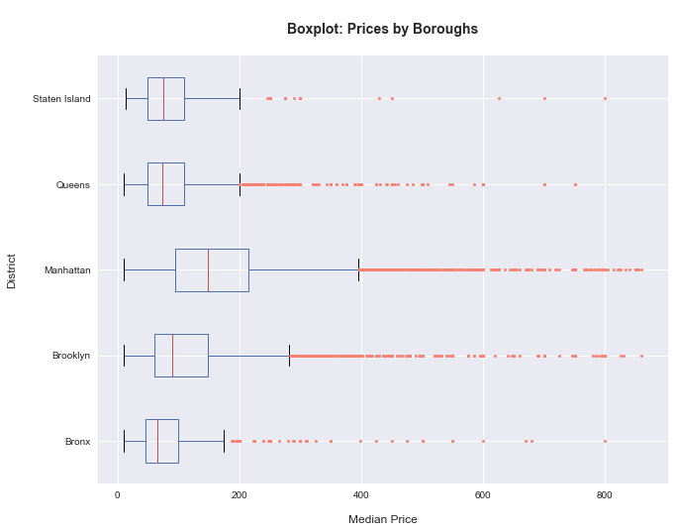
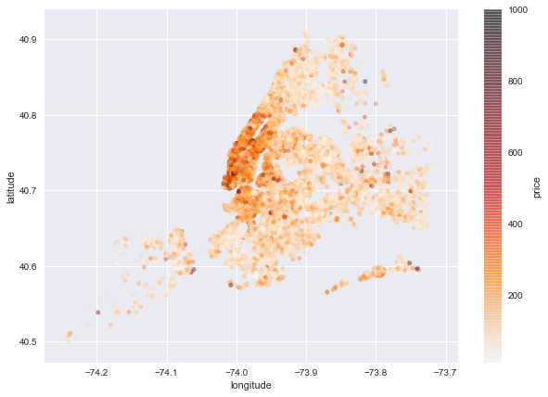
Data Understanding - EDA
Feature generated:
Boroughs Scores
Feature generated:
Distance to City Center

Slide 11
Data Preparation - Cleaning
Missing values
Removed column: Square feet (48088 missing values)
Removed rows: 104 observation with missing values removed
Imputed as False: Profile pic and identity verified
Data leakage
New hosts have no previous reviews and scores
Data format
Stripped ‘$’ and converted to numeric
Categorical variables
Encoding after stripping special characters
Create binary for boolean fields
Notes:
Data leakage is when information from outside the training dataset is used to create the model.
Certain features won’t be available when we are trying to make price recommendations for new hosts.

Slide 12
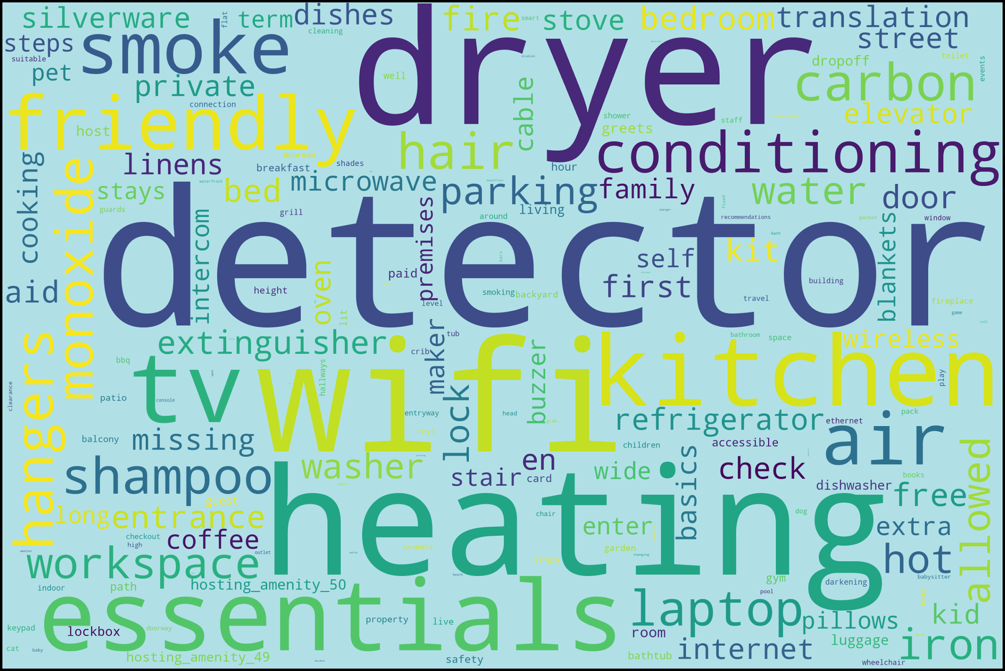
Data Preparation - Feature Engineering
Capture the effect of groups of amenities on price
8 New scoring variables created
Basic amenities
Family friendly
Luxury
Safety and convenience
Unwanted
Most common amenities
Top 10, 20, 30
Notes:
Common amenities: Heating, Wifi, TV, Washer, Kitchen
Dipeeka: two examples luxury and unwanted features - lock on the door

Slide 13
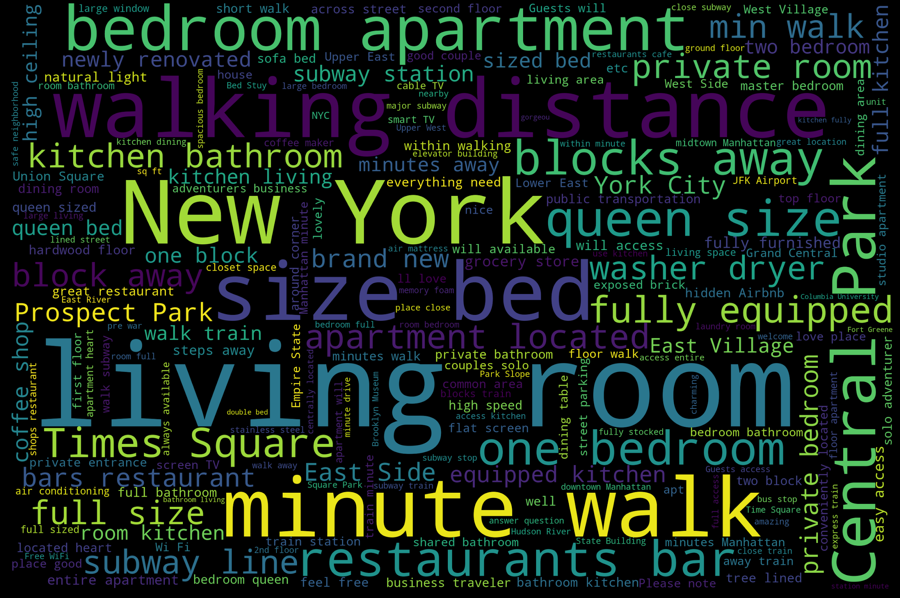
Feature Engineering - Text Analysis
Extract words that reflect certain qualities of the listing
Word cloud: Frequency of words in the “description” column
Used 1000 most common
Private
New
Luxury
Square
Fully equipped
5 New Boolean Variables generated
Notes:
Variables created -> based on features being there or not

Slide 14
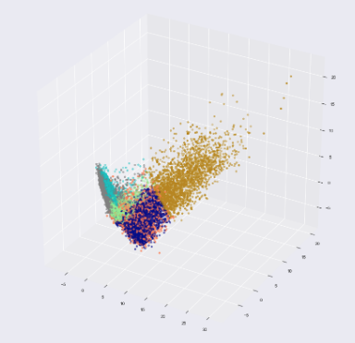
Feature Engineering - Clustering
Objective 1: Use clusters as predictors
Clustering
Original features and PCA
6 as optimal # of clusters from Elbow curve
Created 12 new binary variables
6 cluster-labels for original K Means
6 cluster-labels for PCA K Means
Notes:
Clustering -> to understand features that contribute to high price; use clusters as predictors

Slide 15
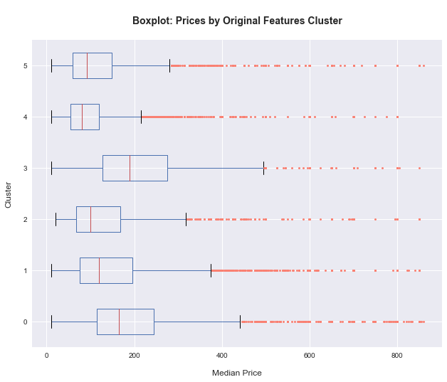
Feature Engineering - Clustering
Objective 2: Understand which features contribute to higher price
Divided 6 clusters into two groups based on price differences
High price group: Cluster 0 and 3
Low price group: Cluster 1, 2, 4 and 5
Created decision tree
To identify features that affect prices the most

Slide 16
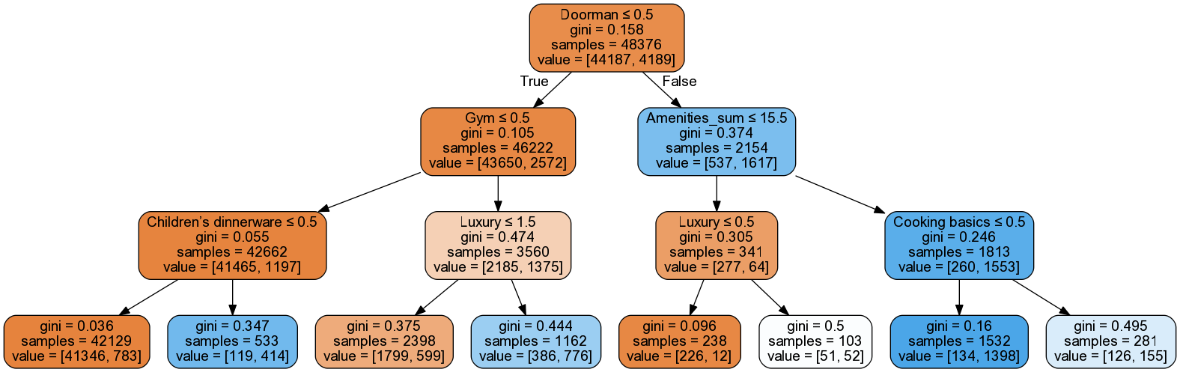
Clustering: Tree Visualization
Value = [Low price clusters, High price clusters]
Our domain knowledge features proved to be highly useful for detecting price differences

Slide 17
Modeling
A variety of numeric prediction models were built, optimized, and evaluated against established performance metrics to ensure they offer value beyond the current system to airbnb and potential hosts

Slide 18
Modeling Process
Algorithms: Lasso; Ridge; Regression Tree; k-NN
5-fold Cross Validation
Evaluation Metric : RMSE
Feature transformation
Standardized features
Unstandardized features
Feature selection
Correlation
Domain Knowledge
Automated Stepwise Forward Selection
Hyperparameter tuning with nested cross validation
Notes:
Elaborate the pros and cons of k-nn later on.

Slide 19
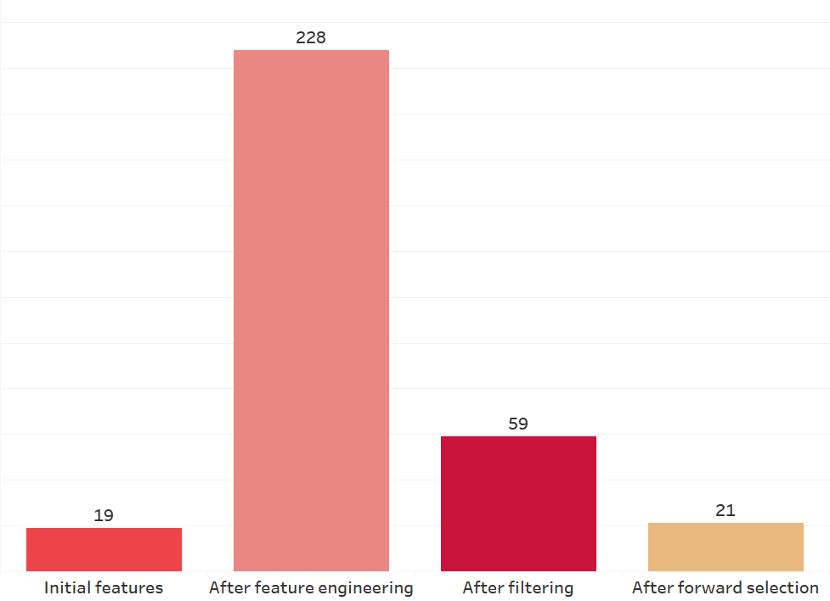
Modeling - Feature Selection
First step: correlation and domain knowledge
Highest correlation - 0.54
Filtered using correlation of more than absolute 0.10
Added features back to capture nonlinear relationships
Second step: Stepwise Forward Selection
Greedy search algorithms
Automatic feature selection
Adds features based on RMSE
Notes:
19 228 59 21

Slide 20
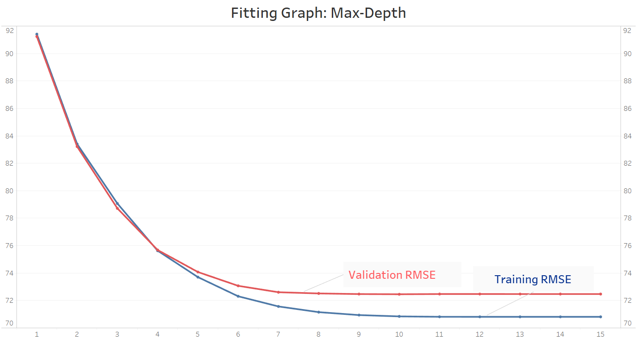
Modeling - Hyperparameter Tuning
Grid Search
Nested Cross Validation
Inner Fold - 5
Outer Fold - 5
Lasso & Ridge
Alpha
KNN
Number of neighbors
Weight or Uniform
Regression Tree
Maximum depth
Minimum sample per leaf
Minimum samples to split
Notes:
max_depth : The maximum depth of the tree.
Min_samples_split: The minimum number of samples required to split an internal node
min_samples_leaf : The minimum number of samples required to be at a leaf node.

Slide 21
Summary of Performances
Models | Raw Model RMSE | Standardized RMSE | Correlated Features RMSE | Automated Selected Features RMSE | RMSE after Hyperparameter Tuning
KNN | 80.46 | 78.57 | 73.68 | 70.87 | 69.90
Lasso | 3914.84 | 72.09 | 72.81 |  | 71.48
Ridge | 3025.36 | 72.15 | 72.82 | 72.72 | 72.58
Regression Trees | 97.41 | 97.66 | 98.06 | 74.16 | 72.59
Notes:
Dimension of interest?
Showi

Slide 22
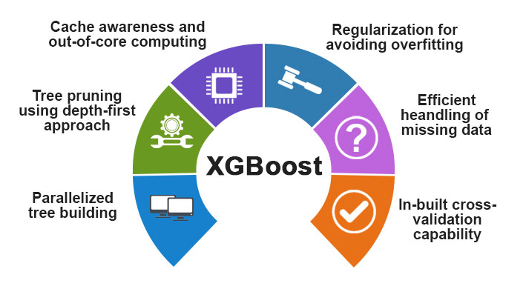
Final Models: k-NN and a good alternative
Key trade-off for price prediction: Accuracy vs. Comprehensibility
k-NN gives us the best generalization performance, also:
Robust to noisy training data , like users’ input
Effective when the training size is large, like Airbnb
However, k-NN is computationally expensive because we need to calculate the distance of every query instance to all training sample
A great alternative: XGBoost
High model performance
RMSE: 67.69
Fast computational speed
Notes:
Boosting is an ensemble technique where new models are added to correct the errors made by existing models. Models are added sequentially until no further improvements can be made. A popular example is the AdaBoost algorithm that weights data points that are hard to predict.
Gradient boosting is an approach where new models are created that predict the residuals or errors of prior models and then added together to make the final prediction. It is called gradient boosting because it uses a gradient descent algorithm to minimize the loss when adding new models.

Slide 23
Evaluation
Evaluation of the model in the context of the business case requires assessing the performance of our final model against the existing price predictor and ultimately validate/reject our hypothesis

Slide 24
Evaluation - Comparison to Existing Platform
Compared Airbnb’s estimated price with our model prediction
For “entire room/ apt” for 2 guests in New York
We predicted around 8000 observations using both our best model and Airbnb’s price estimation
Our model is 13.29% better than Airbnb’s price estimation, which mean we can provide more reasonable pricing guidance for new hosts.
Model / Performance | Airbnb Estimation | Our Model
RMSE | 77.18 | 68.92

Slide 25
Evaluation - Projected Benefits
Evaluation criteria:
Increased revenue
Increased host retention
Increased occupancy rates
Increased customer satisfaction on pricing criteria
Evaluation method: Perform a test run of model through experimentation (A/B testing)
Compare model performance
Compare the evaluation criteria mentioned above

Slide 26
Deployment
The new and improved price estimator needs to be built into the potential host user experience and offer ease of use. Additionally, limitations, risks, and ethical implications must also be considered

Slide 27
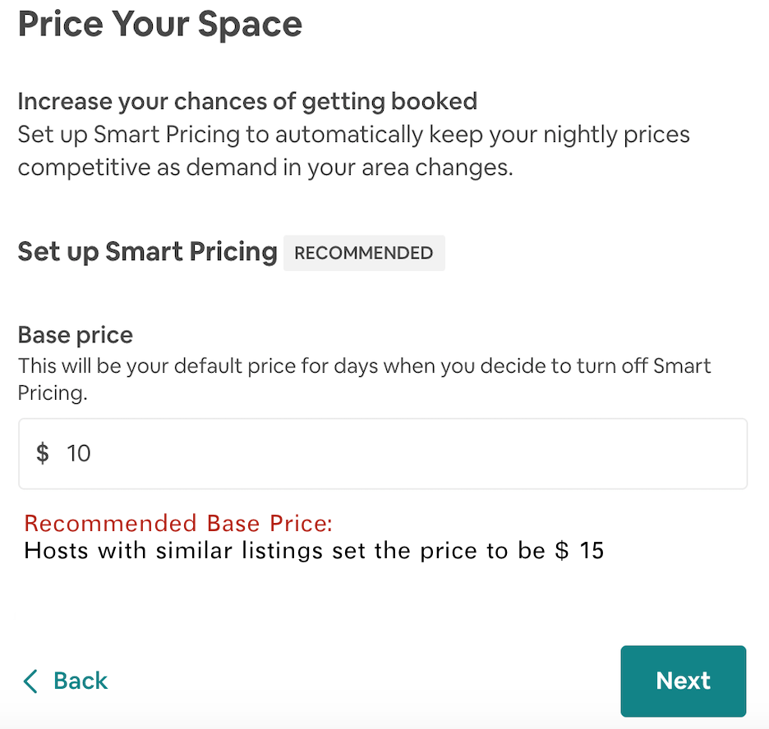
Deployment - Built-in Platform
Integrate model directly into existing interface for new/potential hosts
Prompt Users for Input: Property features
More details higher accuracy
Output: Recommended base price
Users can still take advantage of other existing pricing tools (i.e. Smart Pricing)

Slide 28
Deployment - Concerns & Recommendations
Firm should be aware of...
Limitations
Current model ignores time series effect
Requires detailed input - time consuming for hosts
Frequency of updating database
Future improvements
More Data
Different cities
Enable to build different predictive models for each cluster
More Features
More complicated models - performance oriented

Slide 29
Deployment - Ethical Issues & Risks
Ethical Considerations
No Personally Identifiable Information (PII)
Age, gender, race, etc
Abide by privacy regulations
Risks
Unorganized data
Utilize data from consistent sources
Cost management
Integrate the model into one interface or software to reduce installation cost
Provide intuitive user guide to lower learning cost
Privacy - voluntary self-reported data applied
Data retention - cloud based data storage

Slide 30
Thank you!
ANY QUESTIONS?

